Slide 1
Slides accompanying 2WC12
Sebastiaan de Hoogh

Slide 2
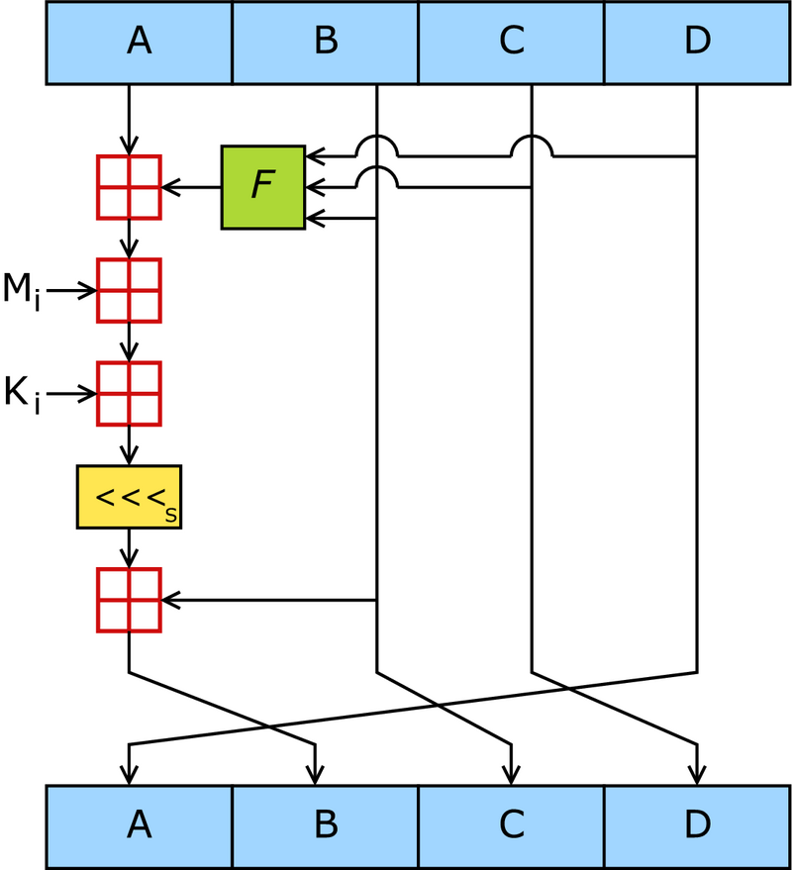
MD5 Compression function

Slide 3
Extra slides, if time permits

Slide 4
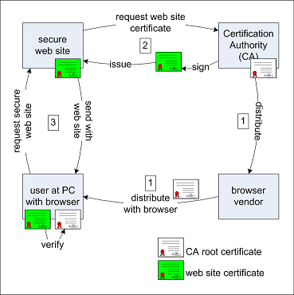
Website Certificates
Source: http://www.win.tue.nl/hashclash/rogue-ca/

Slide 5
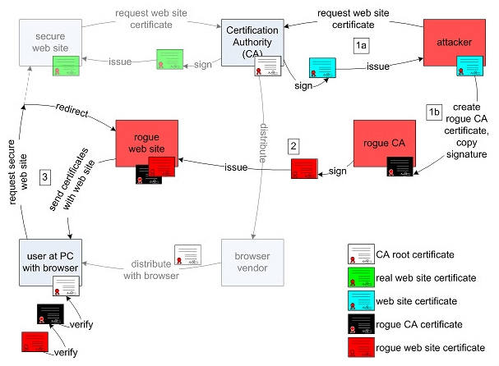
MD5 considered Harmful today
Source: http://www.win.tue.nl/hashclash/rogue-ca/

Slide 6
Creating an intermediate CA
serial number
rogue CA cert
validity period
real cert domain
name
chosen prefix
(difference)
rogue CA RSA key
rogue CA X.509
extensions
CA bit!
real cert
RSA key
Netscape Comment
Extension
(contents ignored by
browsers)
collision bits
(computed)
X.509 extensions
identical bytes
(copied from real cert)
signature
signature
Source: http://www.phreedom.org/research/rogue-ca/

Slide 7
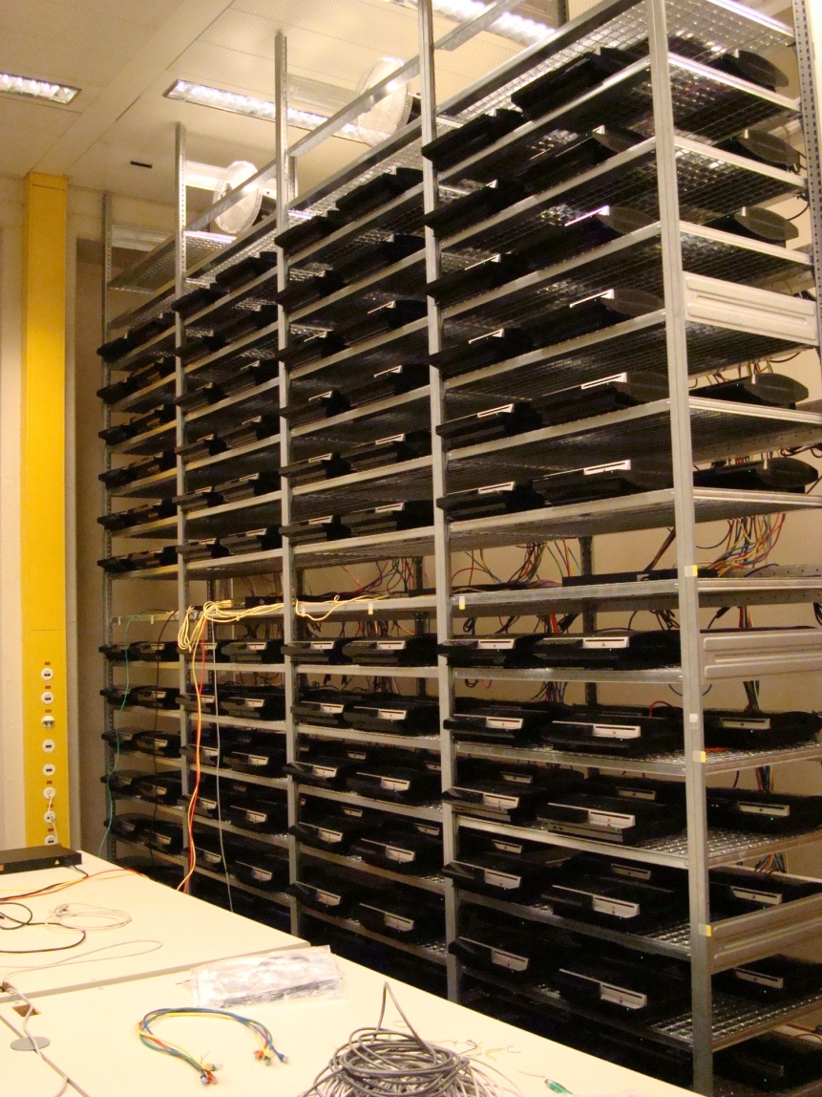
Computing Recources: ”Playstation Lab”
“The birthdaying takes about 18 hours on the 200 PS3s using 30GB of memory that was equally divided over the PS3s”
Source: http://www.win.tue.nl/hashclash/rogue-ca/

